Slide 1

WELCOME TO OUR PRESENTATION!
CSI104 - Team 4 – Presentation 2

Slide 2
CHAP11. DATA STRUCTURE
1. ARRAYS
3. LINKED LISTS
2. RECORDS
Notes:
Trong bài này chúng ta đã đề cập tới 3 cấu trúc dữ liệu tiêu biểu, đó là Array, Record và Linked Lists. Chúng ta sẽ cùng tóm tắt lại về những nội dung này

Slide 3
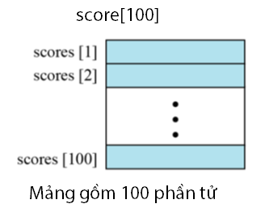
1. ARRAYS
What is an array?
An array is a sequenced collection of elements, of the same data type.
Put the data in order: first, second, third…
and so on.
For example, an array score[100] has 100
elements. We write data in order:
scores[1], scores[2]…

Slide 4
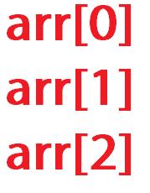
an index
Index
Indicates the location of the element, counting from the beginning of array
In some modern languages, array
indices usually start at 0

Slide 5
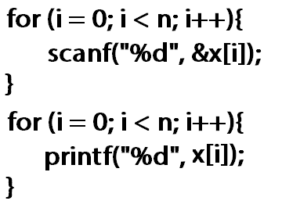
Loops
Read
Process
Write
We use loops to read, process
and write each elements
in an array.
Use for loop in C

Slide 6

Multi – dimensional array
Many applications require that data be stored in more than one dimension.
An example is the 2D array (or the 1D array of 1D array, or a matrix)
Represents rows and columns
For example, the 2D array scores[i][j] has i rows and j columns

Slide 7
Operations
Memory layout
Searching
Insertion
Deletion
Retrieval
Traversal
How each element is stored in memory depends on the computer.
Computers can use row-major storage or column-major storage.

Slide 8
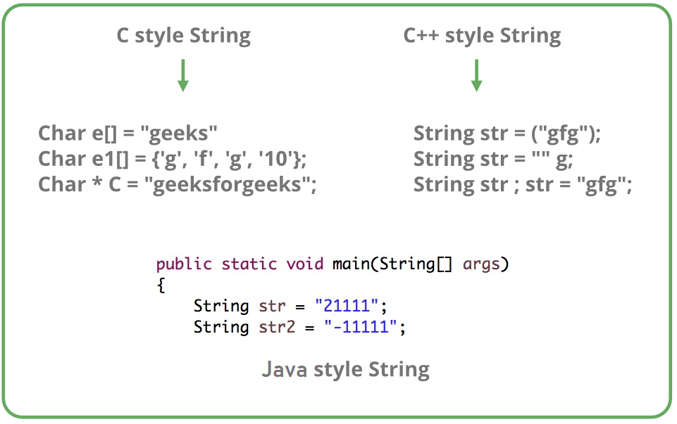
Strings
String is a set of characters.
In C, string is an array of characters
In C++, string can be an array of characters, or a type.
In Java, string is a type.

Slide 9
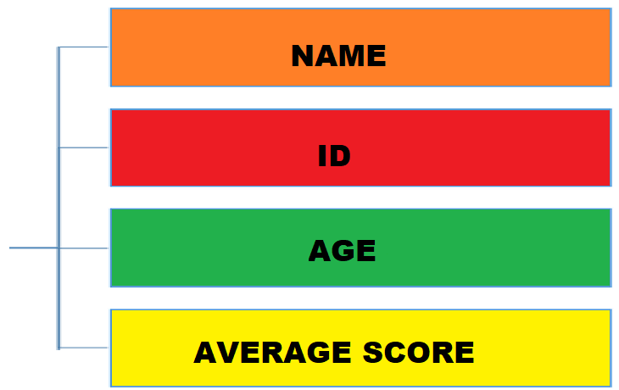

2. RECORDS
What is a record?
Record is a collection of related elements that are in different types,
having a specific name
Each element in a record is called a field.
Field
Record
Student

Slide 10
Record name vs field name
The name of the record is the name of the whole structure
The name of each field allows us to access to that field in the record
Field name
student.name
student.id
Record name
Student

Slide 11
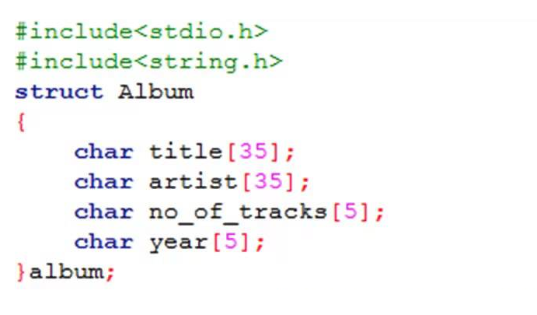
An example of a record in C is the struct data type

Slide 12
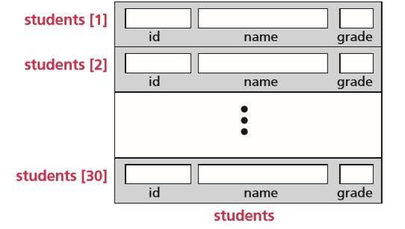
Array of records
Field name
(student[0]).id
(student[1]).id
….
(student[i]).id

Slide 13
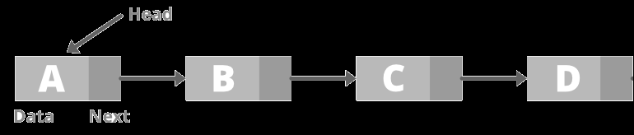
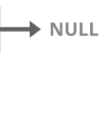
3. LINKED LISTS
A linked list is a collection of data in which each element contains the location
of the next element— that is, each element contains two parts: data and link
The data part holds the value information. The link is used to chain data together
A pointer in the link identifies the next element in the list
The elements in a linked list are traditionally called nodes
A node
A null pointer

Slide 14
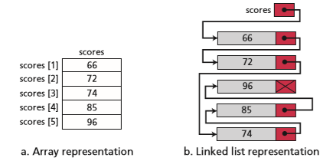
Linked list vs array
In an array, the linking tool is the index indicating the location of an element
In a linked list, the linking tool is the link that points to next element – or the pointer or address

Slide 15
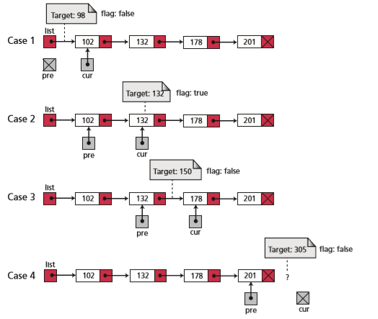
Operations on linked lists
Searching
Scan through the linked list to find a specific value
if found => true
Else => false

Slide 16
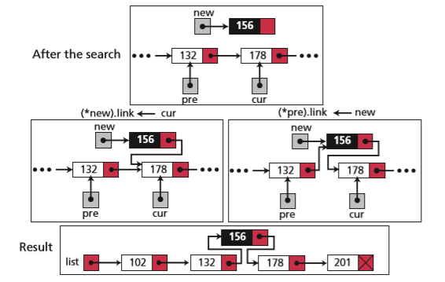
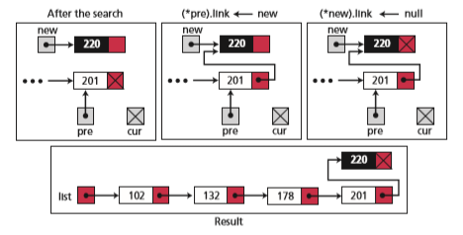
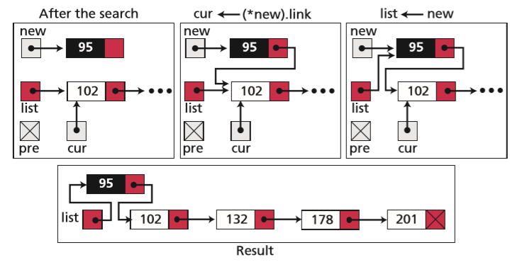
Operations on linked lists
Inserting
If searching return false, then start inserting.
No duplicate values
The node that we want to insert is pointed by a ‘new’ link
In the middle
In the end
At the first

Slide 17
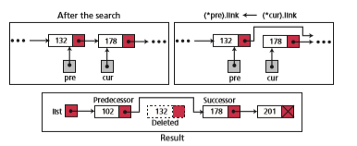
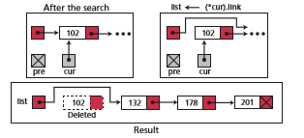
Operations on linked lists
Deleting
In the middle (or end node)
At the first

Slide 18
Operations on linked lists
Retrieving
Retrieving can be a little bit similar to searching, which is finding a node in a linked list.
However, while searching returns true or false when finding a node
Retrieving returns the value when finding a node. (After searching)

Slide 19
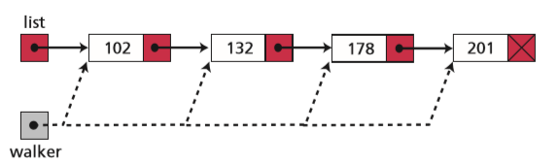
Operations on linked lists
Traversing
Walking
pointer
Ways of traversing is mentioned in Chapter 12.

Slide 20
Operations on linked lists
Searching
Insertion
Deletion
Retrieval
Traversal
The same operations for an array can be applied to a linked list.

Slide 21



